Slide 1
Welcome to American Sign Language, ASL
Nixo Lanning, DI
+
Megan Goldberg, NIC: Certified Interpreter

Slide 2
Snapshots
Immersion- 4 classes
Learning ASL
Attention-getting
Which Hand to use?
The Signing Space
It’s not all in the hands
Questions?

Slide 3
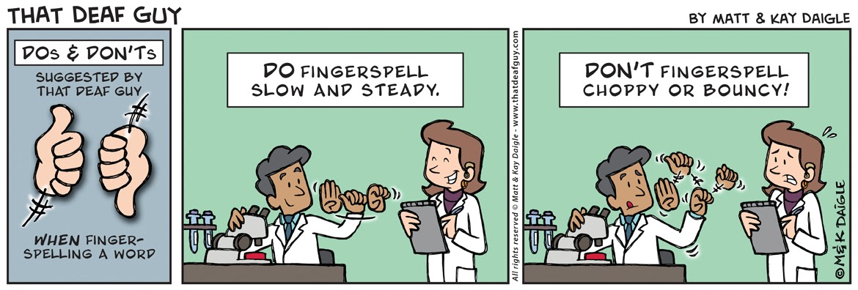

Slide 4
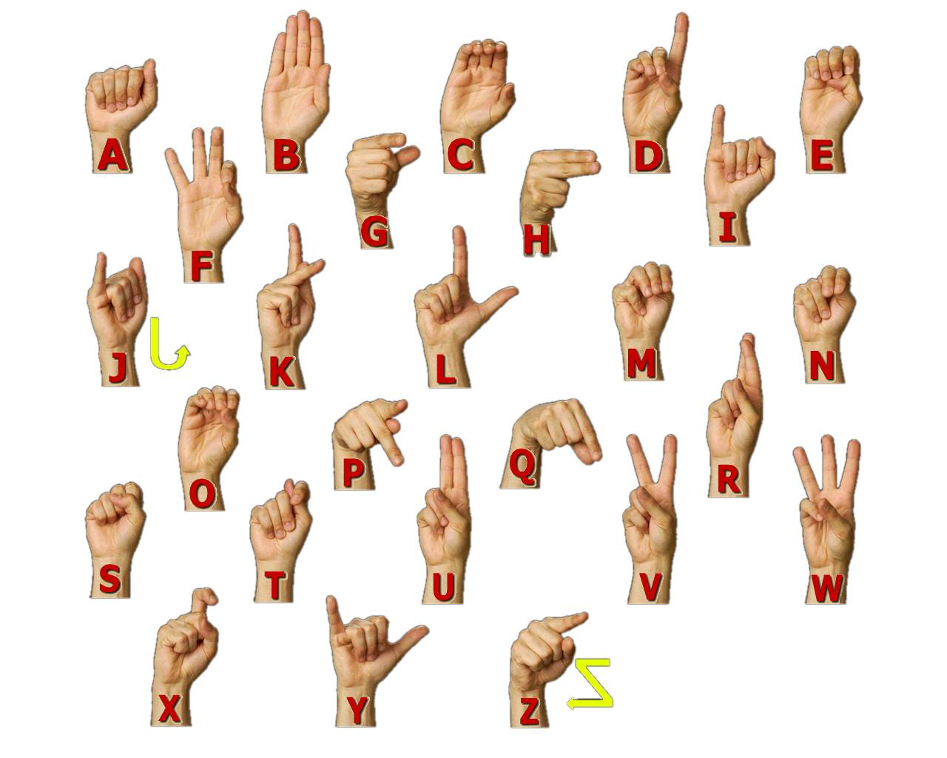

Slide 5
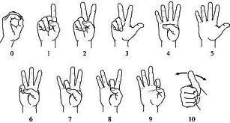

Slide 6
Practice Names
Abam
Bobby
Chann
Diego
Elroy
Fatima
Jade
Keala
Logan
Maria
Miguel
Neema
Omar
Ronin
Sherry
Toyo
Victor
Wyatt
Xiu
Yousef
Zaina
Zina

Slide 7
New Vocabulary for the day
Hello/Hi
Bye
What/Who/Where/When/How
What’s your name
My name is
Me-I
You
He/she/it
Nice to-meet you
See you Later
Good Morning
Good Afternoon

Slide 8
Next Week
Practice fingerspelling (your name, objects, etc)
Work Survival Signs
Questions?

